Slide 1
BASICS OF REST, AND HOW to USE THEM TO BUILD AN EASY, FAST, SINGLE-PAGE WEB APP
Follow on article from this one:
http://cwbuecheler.com/web/tutorials/2013/node-express-mongo/
New one:
http://cwbuecheler.com/web/tutorials/2014/restful-web-app-node-express-mongodb/

Slide 2
WHAT THE HECK IS REST?
Borrow four basic design principles from IBM's developerWorks website,
Use HTTP methods (get, post, etc) explicitly.
Be stateless.
Expose directory structure-like URIs.
Use XML, JavaScript Object Notation (JSON), or both to send data either way.
(These are sort of “back to basics” as HTTP was originally designed.)

Slide 3
1- Use HTTP Methods Explicitly
This one's straightforward. To retrieve data, you use the http GET. To create data, you use POST. To update or change data, you use PUT. To delete data you use DELETE (from the perspective of the server).
So for example, this once-common approach is not a good one:
http://www.domain.com/myservice/newuser.php?newuser=bob
That's an HTTP GET pretending to be a POST. You're GETting the web page and giving it data to store in a DB at the same time.
Instead, create a NewUser service and POST to it.

Slide 4
2- Be Stateless
This is a complicated concept but it boils down to “don't store state information on the server”. If you must save state, save it on the client side via cookies or other methods. (Don’t confuse this with the idea of a web page that writes data to a database.)
A front-end framework like Angular (we will get to that later) is particularly helpful here, as it creates an entire client-side MVC setup where you can save and manipulate the state of elements without hammering your server.
IBM gives a pagination example.
A stateful design would hit a deliverPage service that's been keeping track of the page you're on, and delivers the next one.
A Stateless design would populate prevPage, currPage, and nextPage data in the markup (hidden input fields, JavaScript variables, data- attributes, and so on), and then HTTP GET a newPage service using the nextPage parameter from the markup to request a specific page.

Slide 5
Expose directory structure-like URIs.
Instead of:
http://app.com/getfile.php?type=video&game=skyrim&pid=68
You want:
http://app.com/files/video/skyrim/68

Slide 6
Exchange data using XML, or JavaScript Object Notation (JSON)
Generally use JSON, in all-JavaScript setups like the one discussed in this tutorial.
You can easily manipulate this data in your presentation layer without having to hit your servers, unless you need new data.

Slide 7
Now we will put REST to work by building a very simple single-page web app
We're not building a to-do list (though that's become the “Hello World” of web apps).
We're going to build a simple collection of usernames and emails, much like we did in our previous tutorial.

Slide 8
1st update Express and the Express scaffolding generator globally
Get into a new dir (folder) where we will create a new Express project, and enter
npm update -g express
npm update -g express-generator
Now that we are sure we have the latest bits, build an empty starter project called nodetest2
express nodetest2

Slide 9
open the newly created package.json file and change it so it looks like this:
{
"name": "nodetest2b",
"version": "0.0.0",
"private": true,
"scripts": {
"start": "node ./bin/www“
},
"dependencies": {
"body-parser": "~1.12.4",
"cookie-parser": "~1.3.5",
"debug": "~2.2.0",
"express": "~4.12.4",
"jade": "~1.9.2",
"morgan": "~1.5.3",
"serve-favicon": "~2.2.1",
"mongodb": "^1.4.4",
"monk": "^1.0.1"
}
}
Important Note: this tutorial is a bit out
of date at the moment. It is essential
that you use this older version of the
mongodb module (1.4.4) or monk will
not work and your app will break.
This is all the same things we did
in the previous example.

Slide 10
Back in the nodetest2 directory
Do a
npm install
And npm will drag in all those bits we just defined.

Slide 11
a single-page web app needs, well, a single page,
open views folder, and edit layout.jade
To include jQuery and our master javascript file
doctype html
html
head
title= title
link(rel='stylesheet', href='/stylesheets/style.css')
body
block content
script(src='http://ajax.googleapis.com/ajax/libs/jquery/2.0.3/jquery.min.js')
script(src='/javascripts/global.js')
global.js does not actually exist yet. We're going to create soon.
For now, it'll just quietly 404 in the background when we load our index page

Slide 12
Now edit index.jade which is the only HTML file we'll need for our webapp
extends layout
block content
h1= title
p Welcome to our test
// Wrapper
#wrapper
// USER LIST
h2 User List
#userList
table
thead
th UserName
th Email
th Delete?
tbody
// /USER LIST
// /WRAPPER
There's no data in the table. We're going to populate it,
via AJAX, with data we pull out of our MongoDB database.

Slide 13
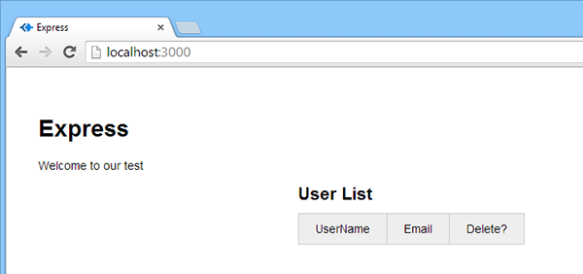
If you run it now
npm start browser to http://localhost:3000

Slide 14
The article uses a local instance of mongodb We are using the cloud version.
Log into your www.mlab.com account
Stay in the same database we used before, but make a new collection: userlist
Then manually add this record:
{ "username" : "test1",
"email" : "test1@test.com",
"fullname" : "Bob Smith",
"age" : 27,
"location" : "San Francisco",
"gender" : "Male"}
We don't really need to add one record, since we're going to be creating an add user routine, but it makes it easier to see that yes, our DB connection is working, as we first start to wire up our app.

Slide 15
Now we’ll edit the JS that runs first, app.js 1st set up DB access
var express = require('express');
var path = require('path');
var favicon = require('serve-favicon');
var logger = require('morgan');
var cookieParser = require('cookie-parser');
var bodyParser = require('body-parser');
// Add for Database
// New code that knows mongo and a nice abstraction layer
var mongo = require('mongodb');
var monk = require('monk');
// add a connection string to mlab.com
// not using local db: var db = monk('localhost:27017/nodetest2');
// use our connection string copied from the cloud mongo.
var db = monk('mongodb://<user>:<pw>@ds053658.mlab.com:53658/somedb');

Slide 16
need to make our database accessible to our various http requests as we did in the first tutorial
find this section:
app.use('/', routes); (might be app.use('/', index);
app.use('/users', users);
Add just above it
// Make our db accessible to our router
app.use(function(req,res,next){
req.db = db;
next();
});

Slide 17
move on to routing
Express auto-creates a /users route file.
We're going to use it, but won't be creating any views for it, because since this is a single-page app, we're using the Index route and view for display purposes.
We're going to use the user route to set up our data I/O … the services we want to create to show, add, and delete users from our database.
We'll access these with JavaScript, rather than navigating to them in a browser, and display the collected data over on the index page.

Slide 18
replace it with our own code
Delete the GET userlist comment and 3 lines below it
Add instead:
/* GET userlist. */
router.get('/userlist', function(req, res){
var db = req.db;
var collection = db.get('userlist');
collection.find({},{},function(e,docs){
res.json(docs);
});
});
Now if you do an HTTP GET to /users/userlist
the server will run this function and return JSON that lists all of the users in the database.
For a large-scale project you'd want to put in limits as to how much data gets listed at
one time, for example by adding paging to your front-end.

Slide 19
Now get our returned data (Bob Smith) to show on our index page
create our global.js file and save it as /nodetest2/public/javascripts/global.js
From the author: “A few notes on my coding style: I like braces and use them always, even for single-line if statements and the like. I like variable names that mean something, rather than trying to be short. I favor single quotes above double quotes. I prefer comments above lines, as opposed to on the right-hand side. I use a LOT of comments, because JS can always be minified so there's really no reason to worry about comments contributing to filesize. I use a decent amount of whitespace for the same reason. Oh, and I like my opening braces on the same line, not a new line.”

Slide 20
In our DOM ready, we call a table-filling method populateTable() (which we’ll define next)
// Userlist data array for filling in info box
var userListData = [];
// do this when the DOM is Ready ==========================
$(document).ready(function() {
// Populate the user table on initial page load
populateTable();
});
// Functions come next ===================================

Slide 21
We make an AJAX call via jQuery, to our server route that returns our collection data.
Then we iterate over the returned JSON to create a content string in which we
concatenate all our HTML into, and then inject that HTML into our existing table.
// Functions ================================
// Fill table with data
function populateTable() {
// Empty content string
var tableContent = '';
// jQuery AJAX call for JSON
$.getJSON( '/users/userlist', function( data ) {
// For each item in our JSON, add a table row and cells to the content string
$.each(data, function(){
tableContent += '<tr>';
tableContent += '<td><a href="#" class="linkshowuser" rel="' + this.username + '">'
+ this.username + '</a></td>';
tableContent += '<td>' + this.email + '</td>';
tableContent += '<td><a href="#" class="linkdeleteuser" rel="' + this._id + '">delete</a></td>';
tableContent += '</tr>';
});
// Inject the whole content string into our existing HTML table
$('#userList table tbody').html(tableContent);
});
};

Slide 22
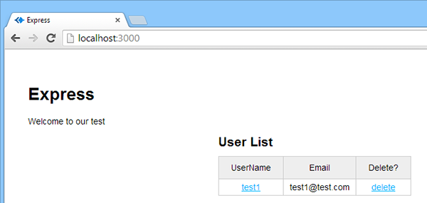
restart app, and again go to http://localhost:3000/
should see our data, after our index page made its call to the server for the data.

Slide 23
But we are not displaying everything we have in our database
Let's set up an info box that will display the full set of user information when we click on a username.
Edit global.js, to add one line to the populateTable() function. This line will stick all of our user data into the array we established earlier. (Not a recommend taking this route if you're dealing with thousands of users. It's not a performance-friendly approach.)
Find this line, and insert this comment and code before the $.each right after it
// For each item in our JSON, add a table row and cells to the content string
// Put our user data array into a userlist variable in the global object
userListData = data;
// this line
$.each(data, function(){

Slide 24
What this is doing
This is putting all of our returned user data, from mongodb, into our global variable, so that we can access it without repeatedly going back up to the server database each time we click a name in our table.
For large-scale operations, this is not a great idea. You would not want to do this if you were loading tens of thousands of users at once (but you probably wouldn't want to load tens of thousands of users at once, either). You'd want to implement paging, and only load the data you really needed for each page.

Slide 25
At the end of the file, where our functions are, add this code on a new line at the bottom:
// Show User Info
function showUserInfo(event) {
// Prevent Link from Firing
event.preventDefault();
// Retrieve username from link rel attribute
var thisUserName = $(this).attr('rel');
// Get Index of object based on id value
var arrayPosition = userListData.map(function(arrayItem) {return arrayItem.username;}).indexOf(thisUserName);
First we're using .map to apply a function to each object in our userListData array.
This will spit out a brand new array containing only whatever the function returns.
That function (the anonymous callback function using the userObj parameter)
strictly returns the username.
So, basically, if our original data array contained two complete user objects,
then the array returned by our use of .map here would only contain usernames,
and look like this: ['Bob', 'Sue'].
So once we have THAT array, provided by .map, we're chaining indexOf,
in combination with the username of our choice,
to get the array index of that username. So Bob would be zero, and Sue would be one.
We can then use that number, stored as arrayPosition, to go back to our original user data
array and start pulling data, in the following code.

Slide 26
Still in that showUserInfo function, add the rest of the code:
// Get our User Object
var thisUserObject = userListData[arrayPosition];
//Populate Info Box
$('#userInfoName').text(thisUserObject.fullname);
$('#userInfoAge').text(thisUserObject.age);
$('#userInfoGender').text(thisUserObject.gender);
$('#userInfoLocation').text(thisUserObject.location); };

Slide 27
Here is all the function code
// Show User Info
function showUserInfo(event) {
// Prevent Link from Firing
event.preventDefault();
// Retrieve username from link rel attribute
var thisUserName = $(this).attr('rel');
// Get Index of object based on id value
var arrayPosition = userListData.map(function(arrayItem) { return arrayItem.username; }).indexOf(thisUserName);
// Get our User Object
var thisUserObject = userListData[arrayPosition];
//Populate Info Box
$('#userInfoName').text(thisUserObject.fullname);
$('#userInfoAge').text(thisUserObject.age);
$('#userInfoGender').text(thisUserObject.gender);
$('#userInfoLocation').text(thisUserObject.location); };

Slide 28
Need to trigger that function on a click
Go back up in our DOM ready section, below the initial call to populate the table, add this code
// Username link click
$('#userList table tbody').on('click', 'td a.linkshowuser', showUserInfo);
We've found our user object and we're populating spans with data.
Better now add the spans

Slide 29
open up /views/index.jade
add the following code right after the #wrapper line (and above our user list table)
Remember indents in jade are critical
// USER INFO #userInfo
h2 User Info
p
strong Name:
| <span id='userInfoName'></span>
br
strong Age:
| <span id='userInfoAge'></span>
br
strong Gender:
| <span id='userInfoGender'></span>
br
strong Location:
| <span id='userInfoLocation'></span>
// /USER INFO

Slide 30
extends layout
block content
h1= title
p Welcome to our test
// Wrapper
#wrapper
// USER INFO
#userInfo
h2 User Info
p
strong Name:
| <span id='userInfoName'></span>
br
strong Age:
| <span id='userInfoAge'></span>
br
strong Gender:
| <span id='userInfoGender'></span>
br
strong Location:
| <span id='userInfoLocation'></span>
// /USER INFO
// USER LIST
h2 User List
#userList
table
thead
th UserName
th Email
th Delete?
tbody
// /USER LIST
// /WRAPPER

Slide 31
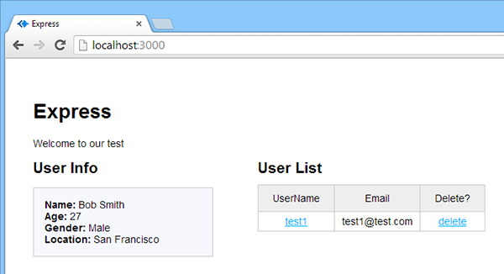
http://localhost:3000 you'll see an unpopulated user info box floating over to the left.
Click on the “test1” username in your table, and it should populate that box with Bob's info.

Slide 32
In the next PPT
We will add some more users by doing some AJAX posting.

